Slide 1
Working with ros topics

Slide 2
Working with ros topics
Publisher – Subscriber communication through topics is a common method of interaction between ROS nodes
The connection is unidirectional, and should be used to transfer continuous data stream
This part will provide a example of a pub/sub pair sending standard ROS-defined type, as well as sending custom message
You can easily try these examples out, as well as modify them to your liking.
*Prerequisite:
A catkin workspace has been set up
A package created with dependency on roscpp and std_msgs (use command: $ catkin_create_pkg <package_name> roscpp std_msgs in the /src folder of your catkin workspace)
For this case, we will use “simple_pub_sub” as the package name

Slide 3
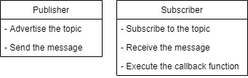
Publisher and subscriber
Here is an overview of the function of the publisher and subscriber node:
The publisher advertise the topic to the master and send the message
The subscriber subscribe to the topic with the master, receive and work with the data in the callback function
We will start with sending standard ROS messages

Slide 4
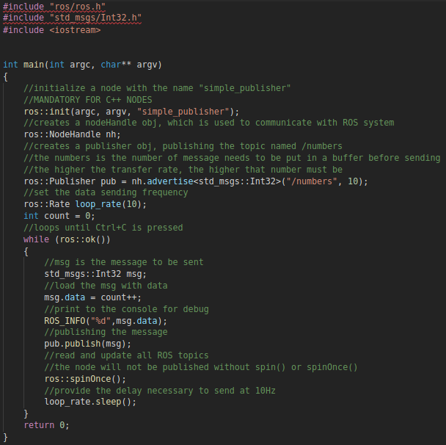
publisher (standard messages)
In this example, we will have the publisher send an integer through a topic call “/number”
We take a look at a publisher
The basic structure is:
Initialize a node, node handler, Publisher obj
Have the node handler advertise the topic
Publish the message

Slide 5
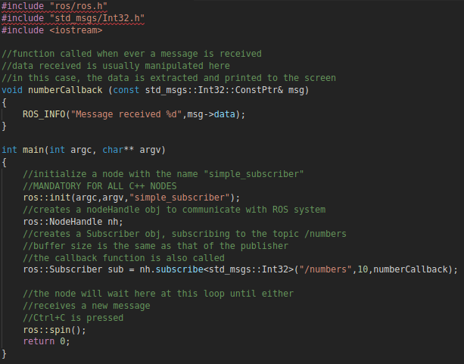
Subscriber (standard messages)
The topic “/numbers” is now registered to master
We take a look at the subscriber
The basic structure is:
Initialize a node, node handler, Subscriber obj
Have the node handler subscribe to the topic
Manipulate the data received in the callback function
Poll to wait for more messages

Slide 6
Working with ros topics (standard messages)
To build and compile the nodes we have just written, we have to add (or uncomment) a few things to the CMakeList.txt file.
find_package(catkin REQUIRED COMPONENTS roscpp std_msgs message_generation)
generate_messages(DEPENDENIES std_msgs)
catkin_package()
include_directories(include ${catkin_INCLUDE_DIRS})
Add the following to the package.xml file
<build_depend>roscpp</build_depend> <run_depend>roscpp</run_depend> <build_depend>message_generation</build_depend> <exec_depend>message_runtime</exec_depend>

Slide 7
Working with ros topics (standard messages)
For each node we have created, we will add the following (we will use the publisher node as an example):
add_executable(simple_publisher src/simple_publisher.cpp)
target_link_libraries(simple_publisher ${catkin_LIBRARIES})
add_dependencies(simple_publisher ${PROJECT_NAME}_generate_message_cpp)
Do the same thing for every node added to the package

Slide 8
Build and run
After having finished all the modifications to the CMakeList.txt, all that’s left is to build and test the nodes.
Build the package with:
$ cd ~/catkin_ws
$ catkin_make
Run the nodes:
$ roscore
(in a different terminal) $ rosrun simple_pub_sub simple_publisher
(in a different terminal) $ rosrun simple_pub_sub simple_subscriber

Slide 9

Working with ros topics (custom messages)
Sending a custom message is just like sending a standard ROS message
The only difference is that we are treating the .msg file as if it is a struct with each member being the fields declared inside it
Example: sending the message ID.msg with the content:
In our program, we can treat a variable ‘msg’ of type <simple_pub_sub::ID> to have 3 fields: msg.age, msg.firstName and msg.lastName.

Slide 10
Creating a custom message
Creating a custom message:
In your package, create a new folder named msg: $ mkdir msg (use $ cd ~/catkin_ws/src/<package_name> to navigate to your package)
Create a new text file in your msg folder and name it ID.msg (the name can be anything): $ gedit ID.msg
Add the fields you want to send over your ROS topic. In this case, we are sending an unsigned integer and 2 strings

Slide 11
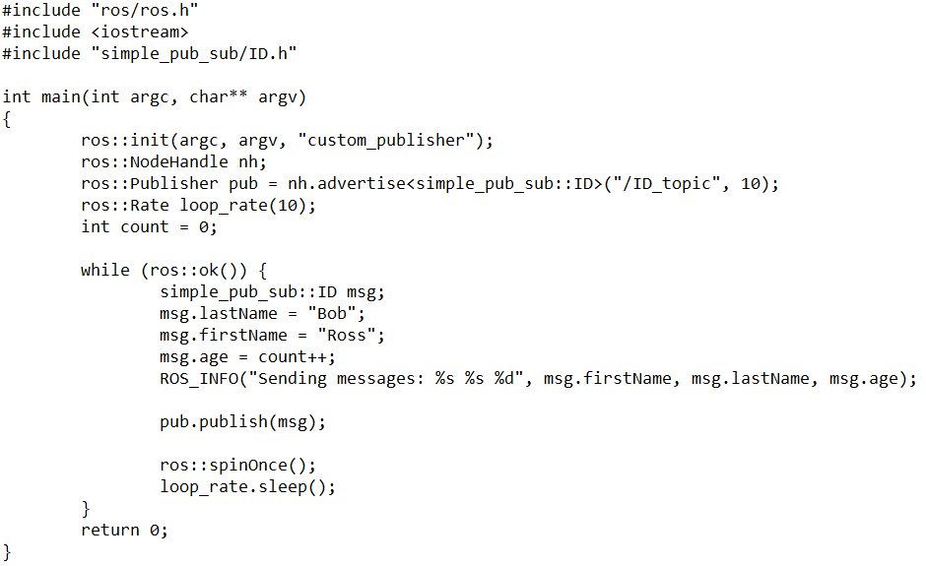
publisher (custom messages)
Here we have an example of a custom publisher
The key differences are:
We include the .msg file as a header to use the message
The message file name is treated as if it was a struct

Slide 12
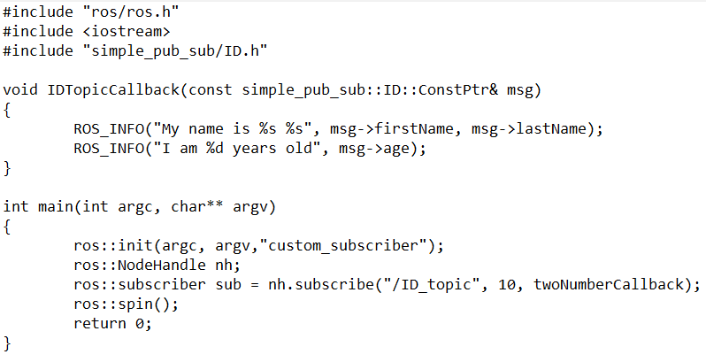
subscriber (custom messages)
Here is an example of a subscriber
The differences are similar to that of the publisher

Slide 13
Build and run
The CMakeList.txt file needs the same modification as with the standard message.
In addition to that, we also need to include the message file by including:
add_messages_files(DIRECTORY msg FILES ID.msg)
We then build and run the nodes normally.

Slide 14
Ros::spin() and ros::spinOnce()
In the preceding examples, the publisher has ros::spinOnce() and the subscriber has ros::spin(), both are used to give control over to ROS, however, they are slightly different.
ros::spinOnce() tells ROS to execute all pending callbacks from the node’s subscription and return the control back to us
ros::spin() tells ROS to wait for and execute callbacks until the node shuts down
If your program has repetitive work to do (other than responding to callbacks) then use ros::spinOnce(). Otherwise use ros::spin()

Slide 15
conclusion
The communication using topics is fast many-to-many and unidirectional
The content of the message itself should NEVER be modified directly from the subscriber, as there can be multiply nodes subbing to the same topic
Communication through topic should be used for continuous data stream, for example: sensor data, robot state, etc.

